Slide 1

Lemon Tree Hotels
User Guide

Slide 2
USERS
User Type | Username | Password | Description
Admin | - | -
Supervisor | ltsupervisor | Welcome@12 | Lemon Tree Supervisor
Agent | ltagent | Welcome@12 | Lemon Tree Agent

Slide 3
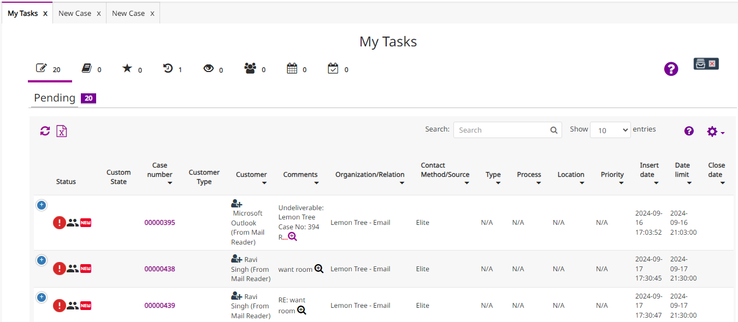
SUPERVISOR
1. My Tasks

Slide 4
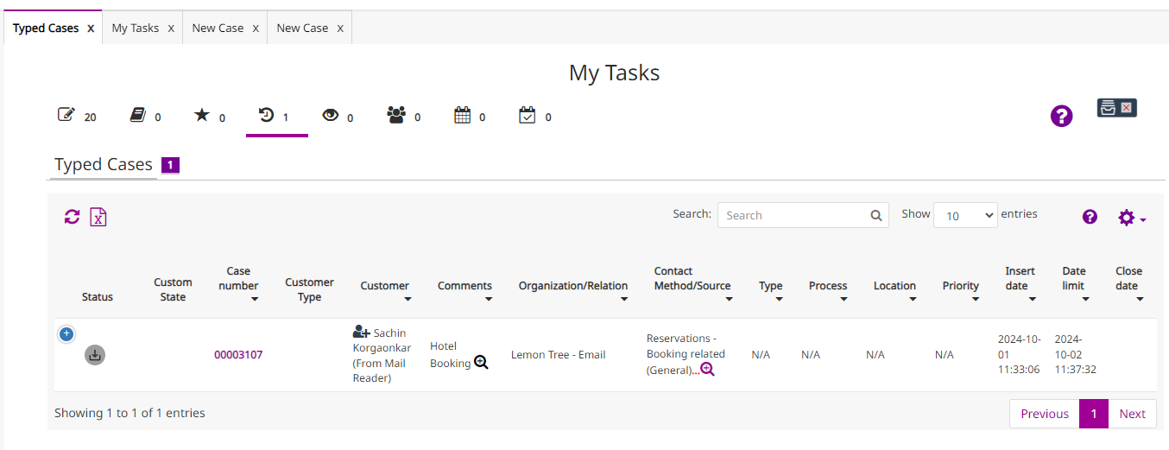
SUPERVISOR
2. Typed Cases

Slide 5
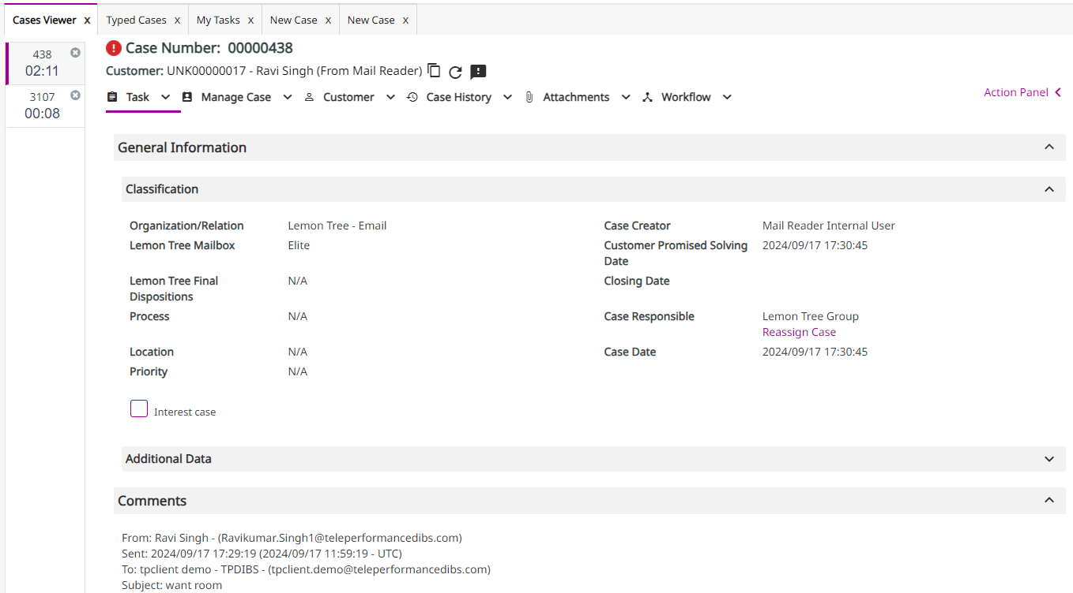
SUPERVISOR
Case viewer | Tasks (Case number: 00000438)

Slide 6
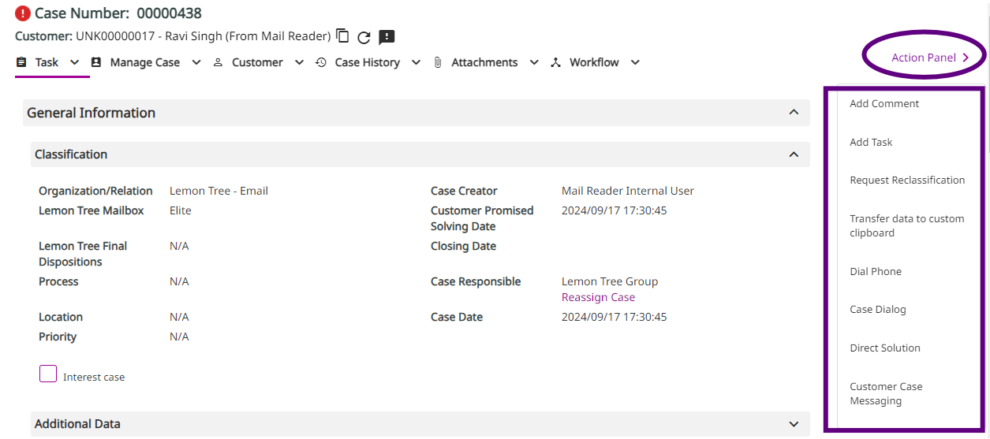
SUPERVISOR
Case viewer | Action Panel (Case number: 00000438)

Slide 7
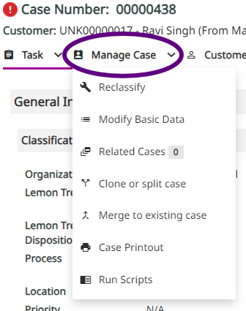
SUPERVISOR
Case viewer | Manage Case (Case number: 00000438)

Slide 8
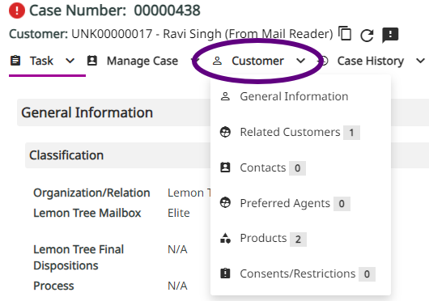
SUPERVISOR
Case viewer | Customer (Case number: 00000438)

Slide 9
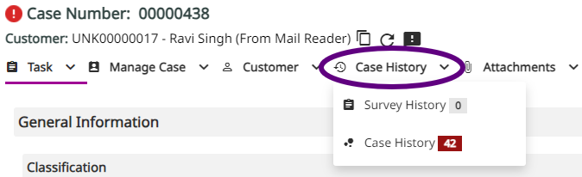
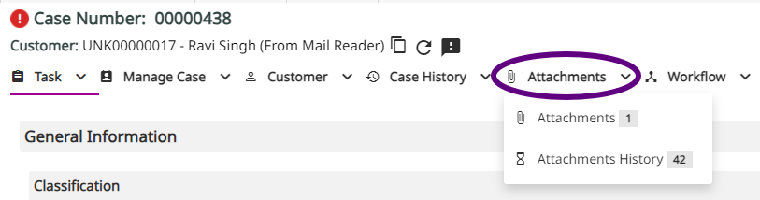
SUPERVISOR
Case viewer | Case History (Case number: 00000438)
Case viewer | Attachments (Case number: 00000438)

Slide 10
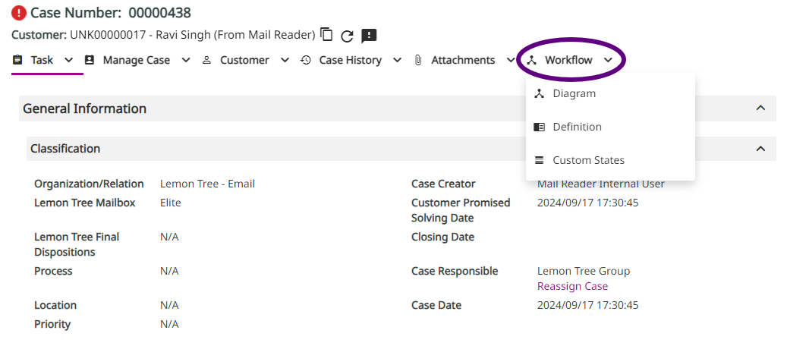
SUPERVISOR
Case viewer | Workflow (Case number: 00000438)

Slide 11
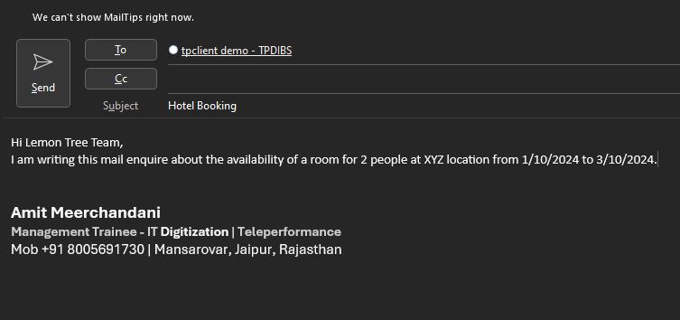
SUPERVISOR
When customer enquire through mail

Slide 12
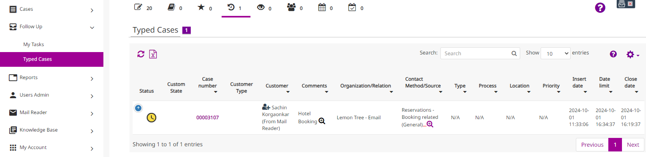
SUPERVISOR
Supervisor and agent can see the mail listed in typed cases section

Slide 13
SUPERVISOR
Once agent will open the mail then they can do further tasks.

Slide 14
Agent

